Slide 1
polymorphic
classes

Slide 2
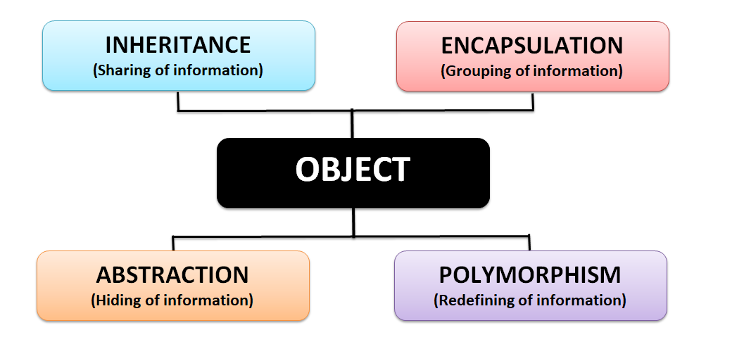
4 pillars of object oriented code

Slide 3
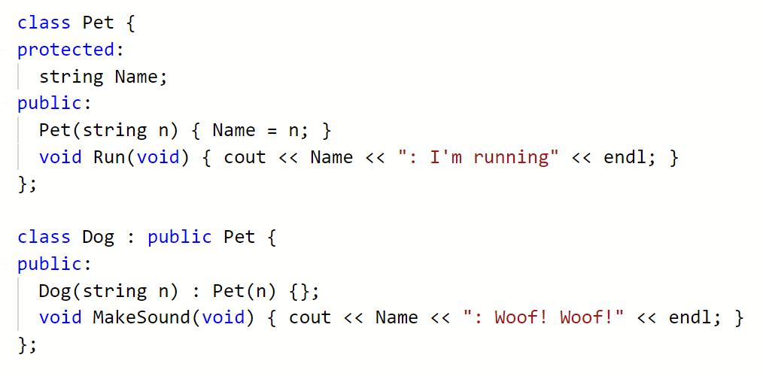
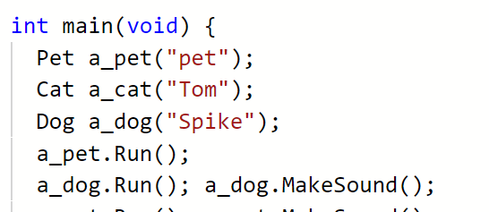

Slide 4
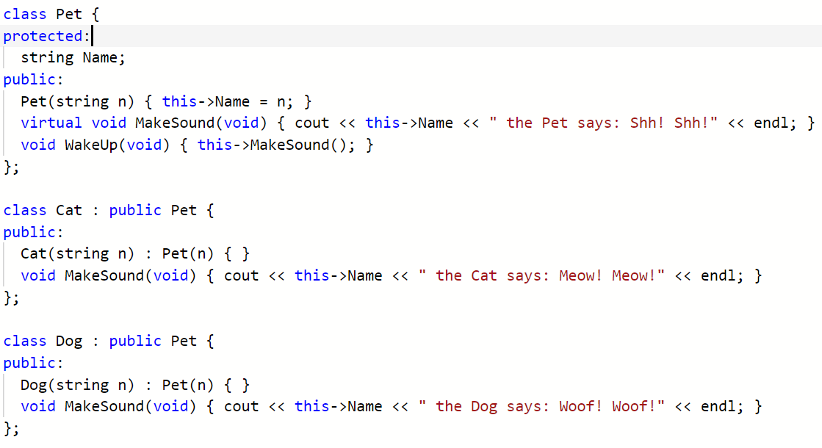

Slide 5
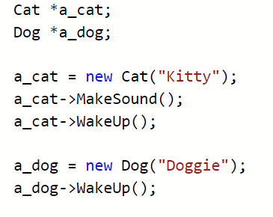


Slide 6
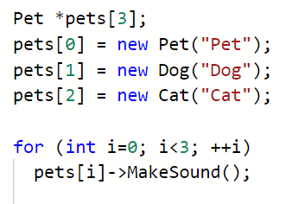


Slide 7
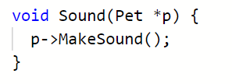



Slide 8
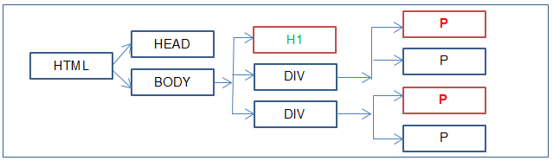
today
<html>
<head></head>
<body>
<h1>Title</h1>
<div>
<p>
Something
</p>
[… etc …]
</body>
</html>
Construct the following using OO and polymorphic techniques:
Shape
Square, circle, triangle, hexagon, pentagon
Area, perimeter, draw (render)
Cube, cylinder, other polyhedral
Surface area, volume
Or
HTML tags
Pretty print / render() method

Slide 9
